Slide 1
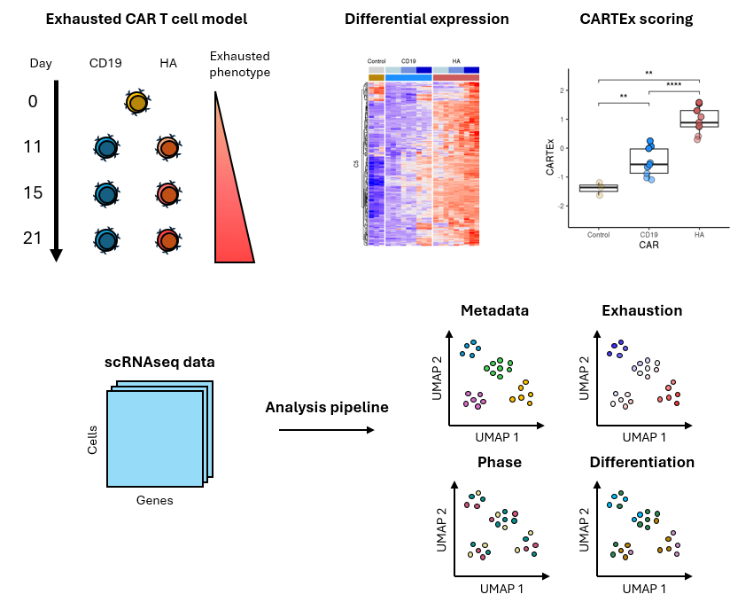
CARTEx project
Graphical abstract

Slide 2
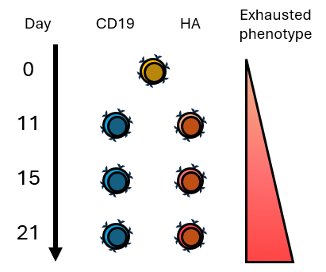
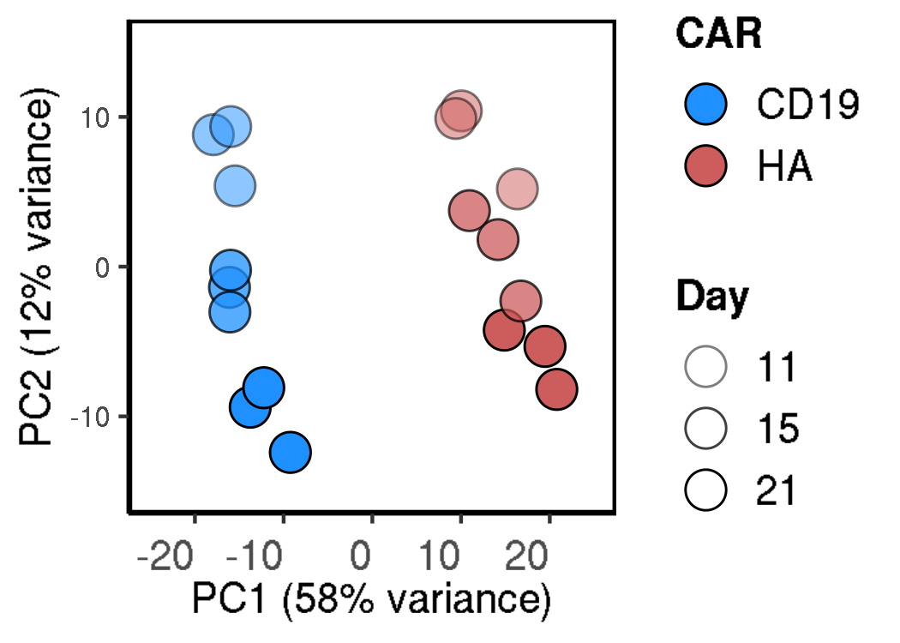
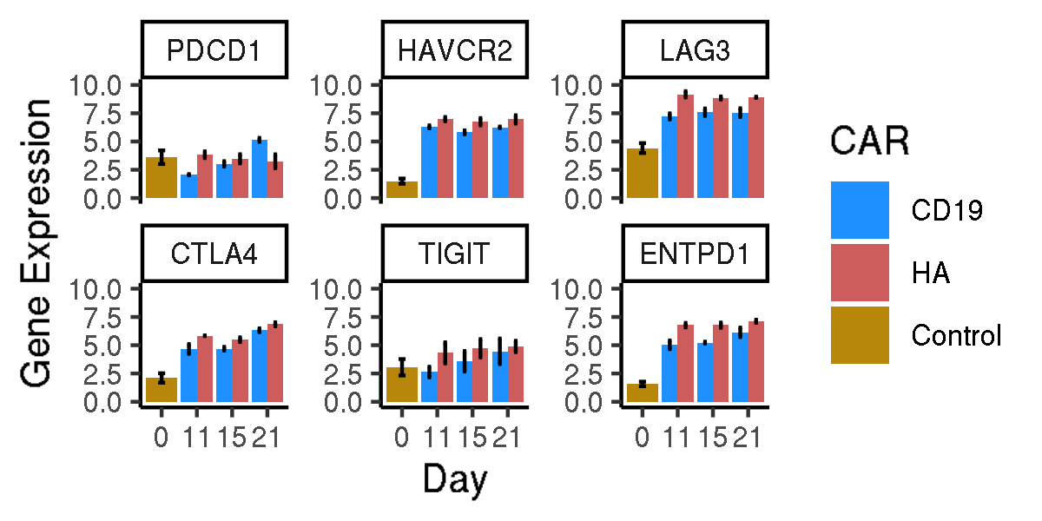
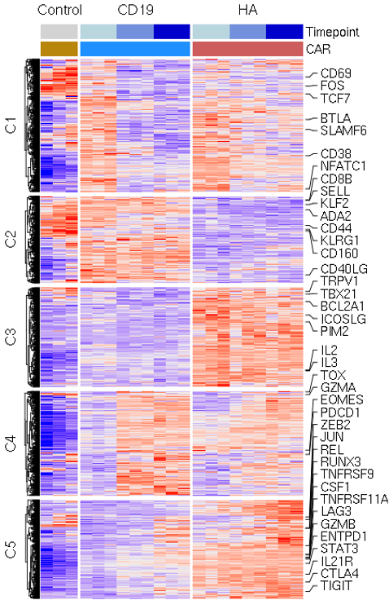
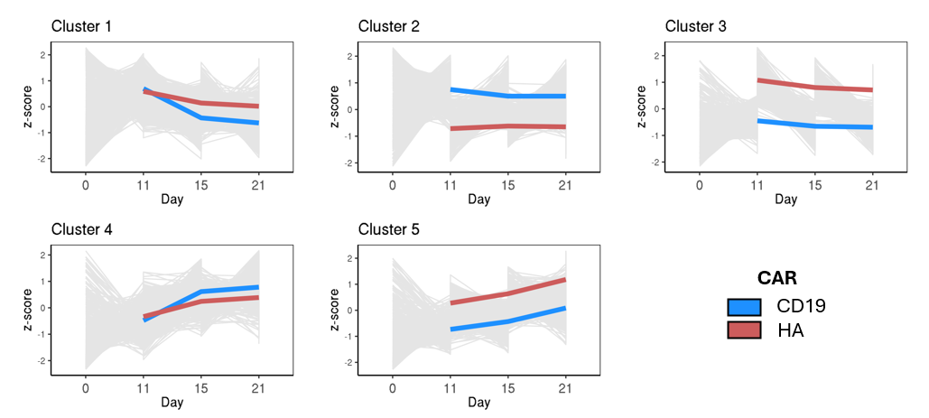
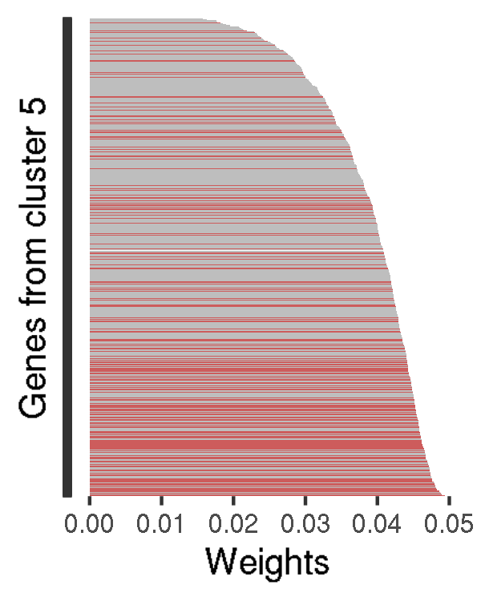
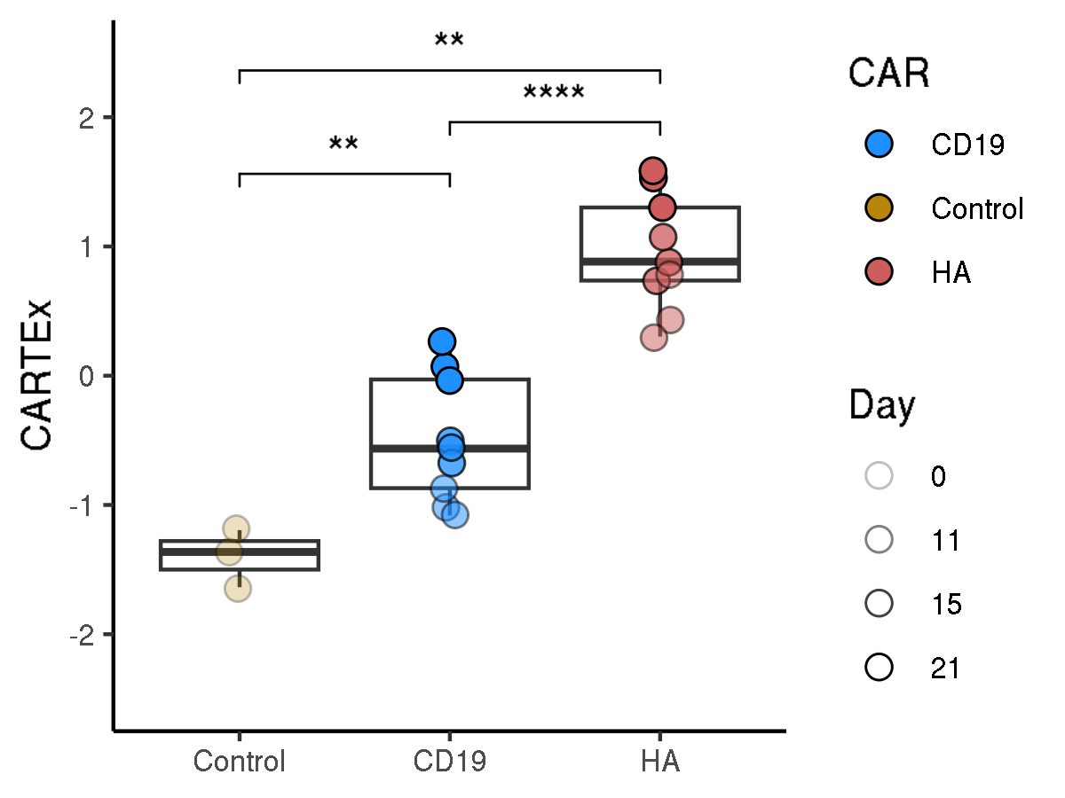
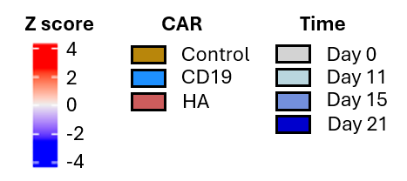
CARTEx project
Figure 1. Bulk RNA sequencing of functional and exhausted CAR T cells across 21 days
A
B
C
D
E
F
G

Slide 3
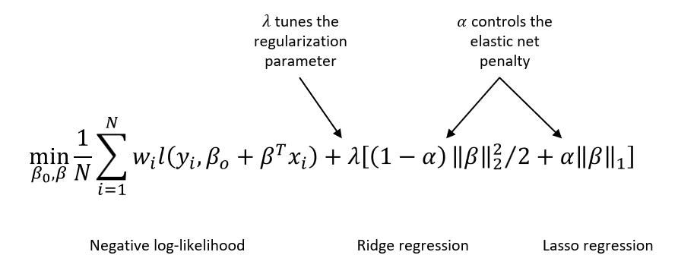
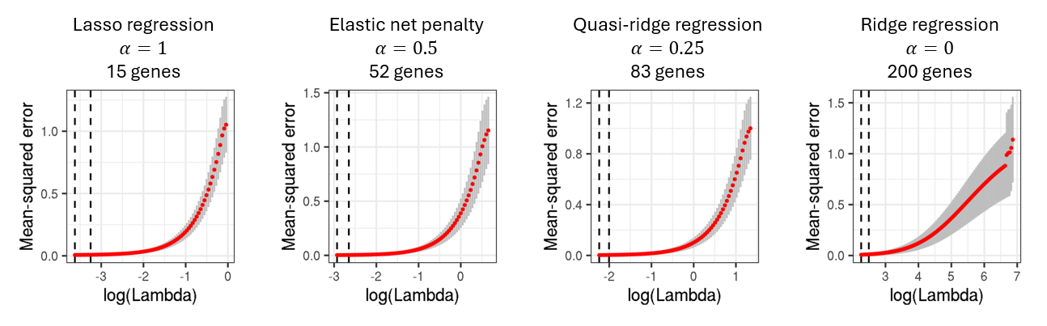
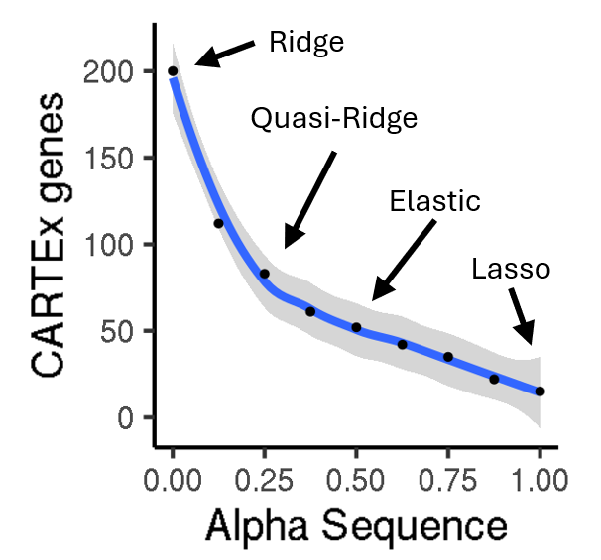
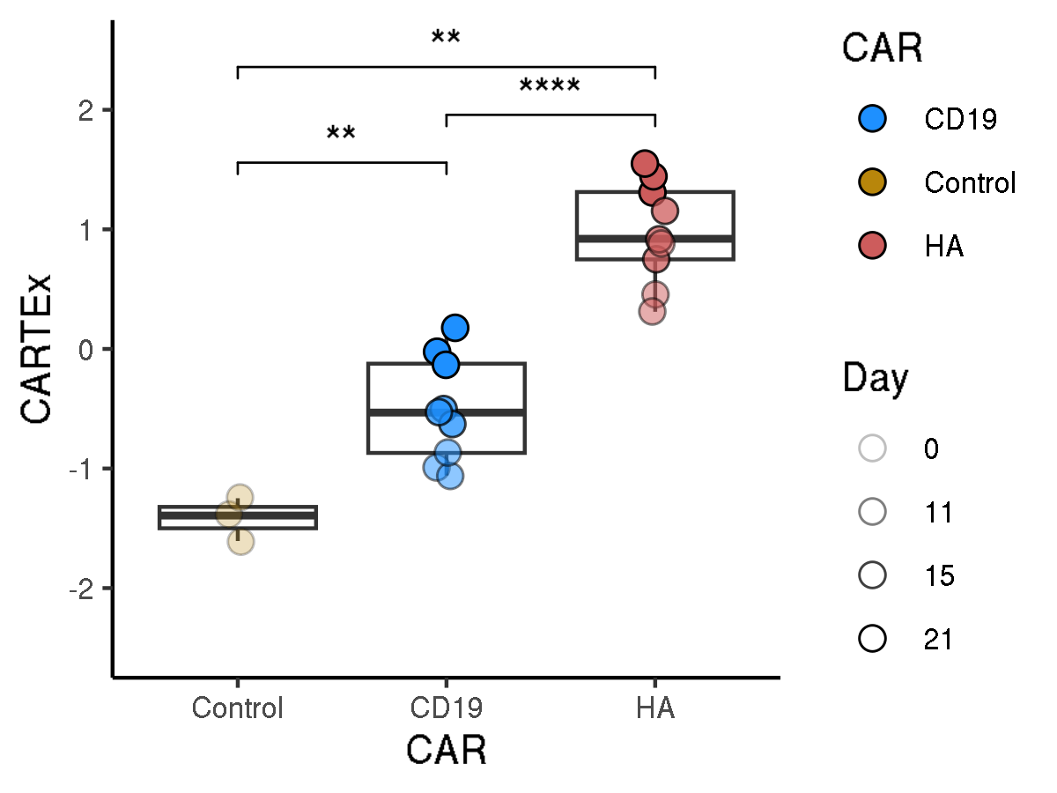
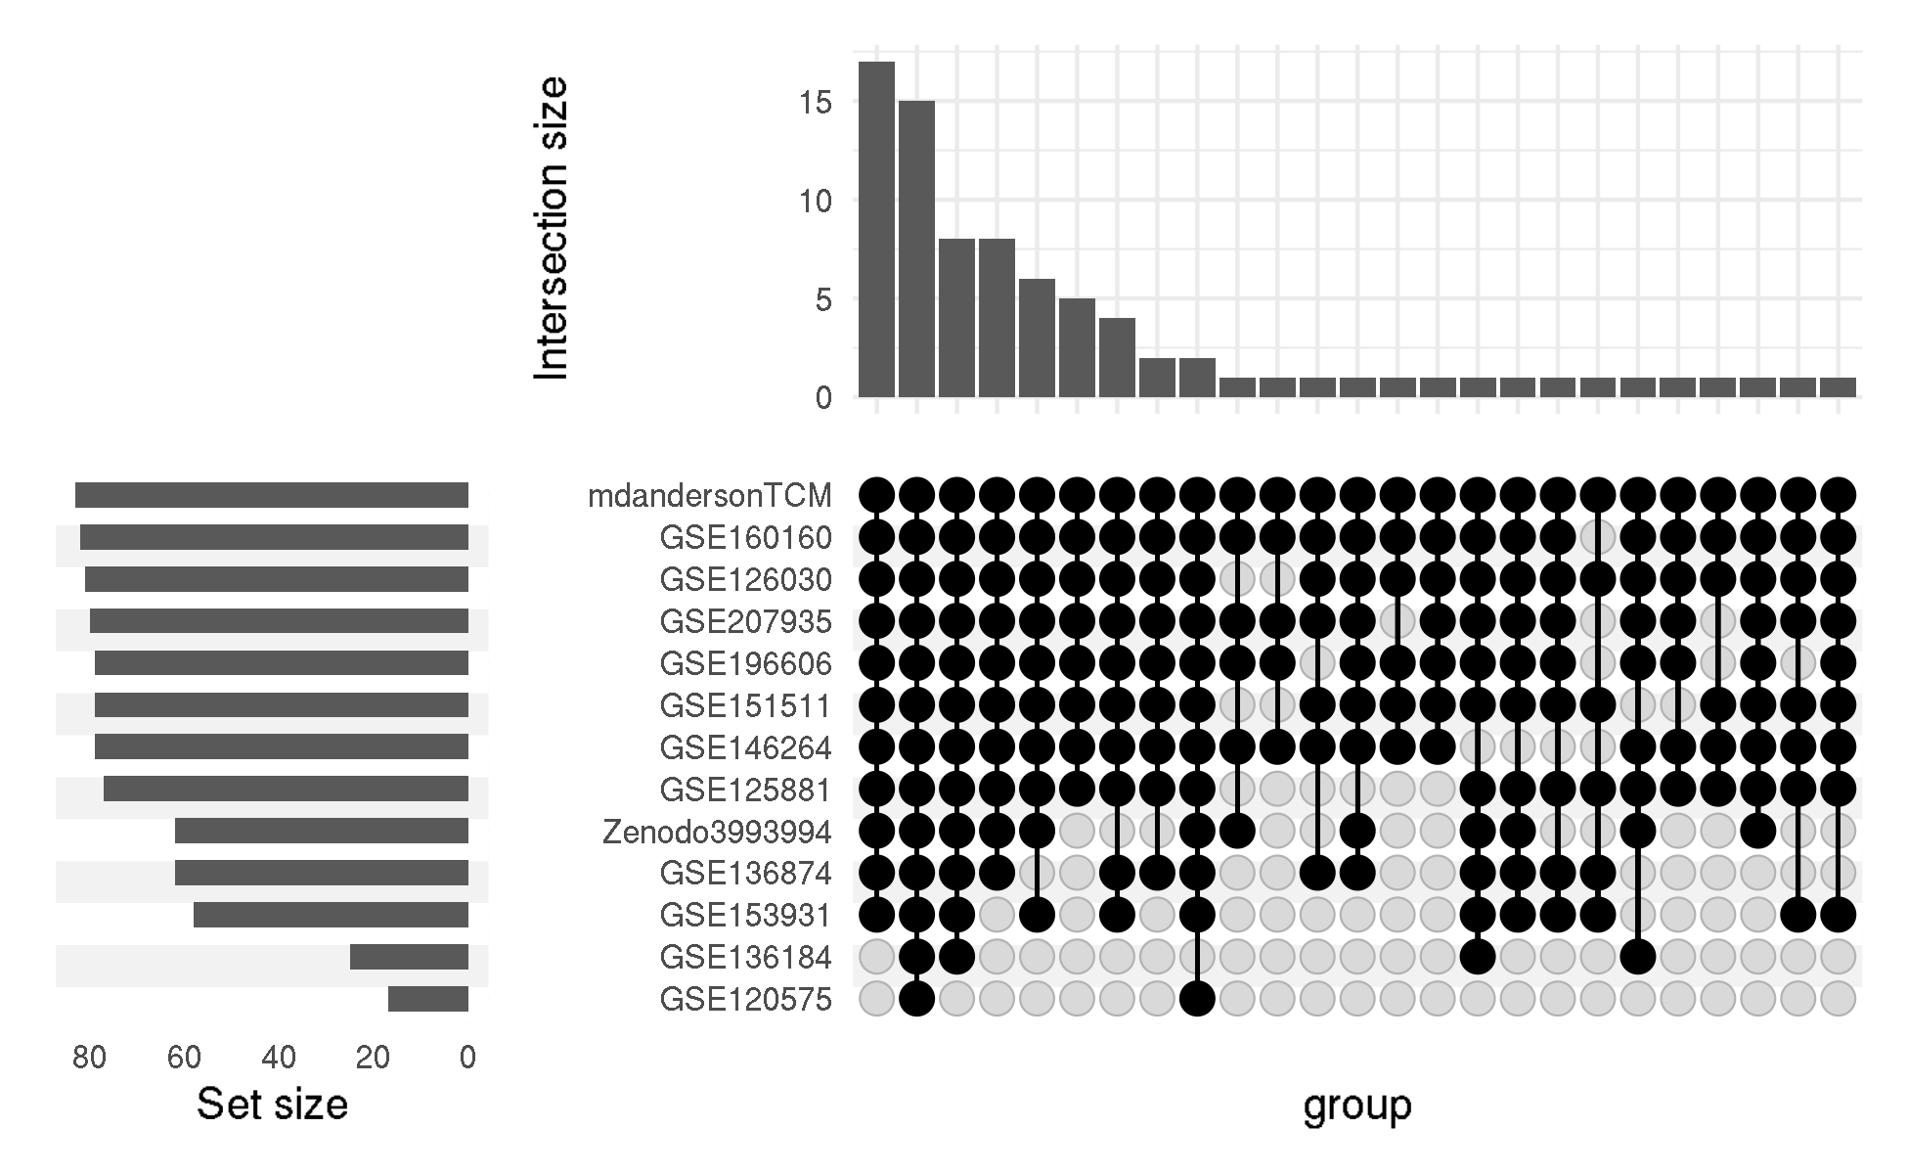
CARTEx project
Supplementary Figure 1. glmnet
A
B
C
D
E

Slide 4
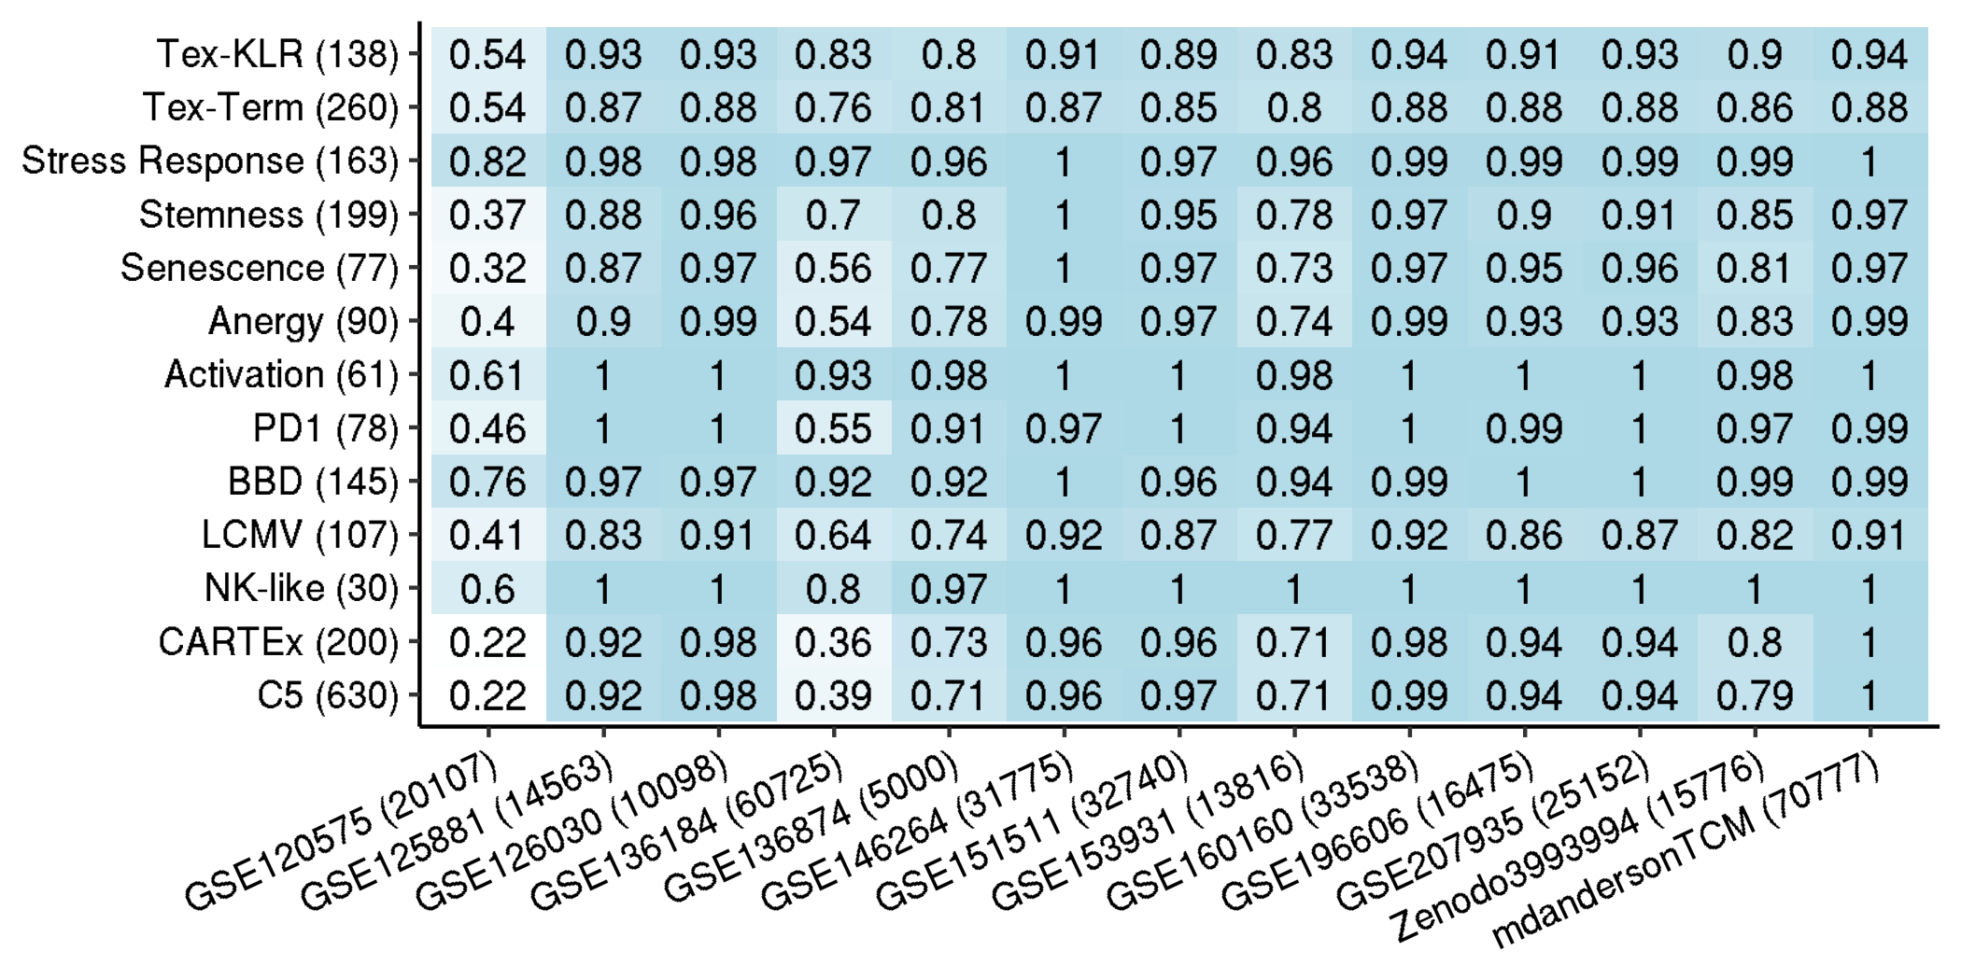
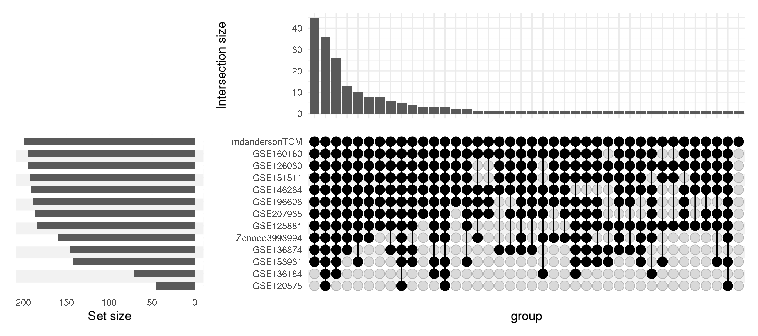
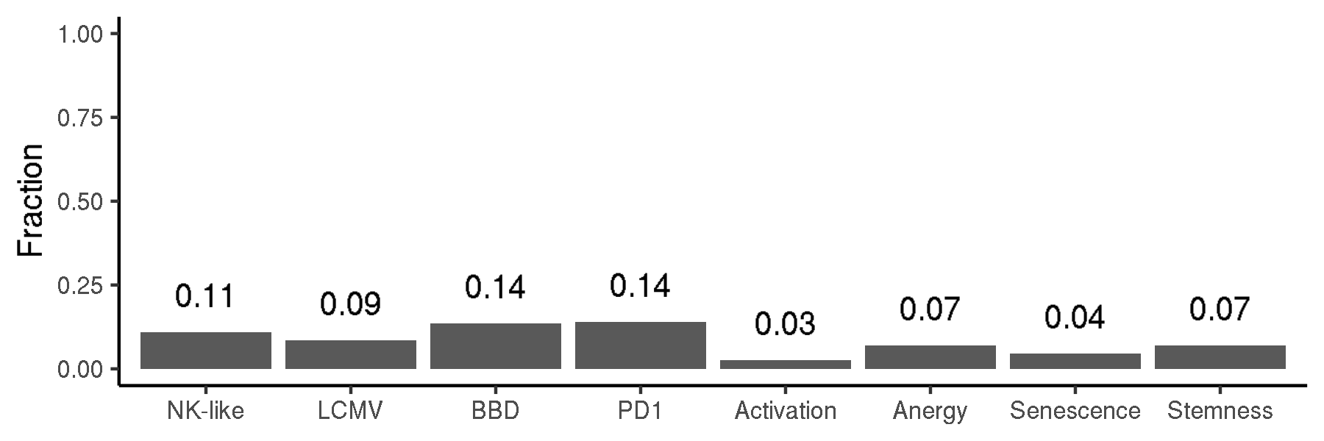
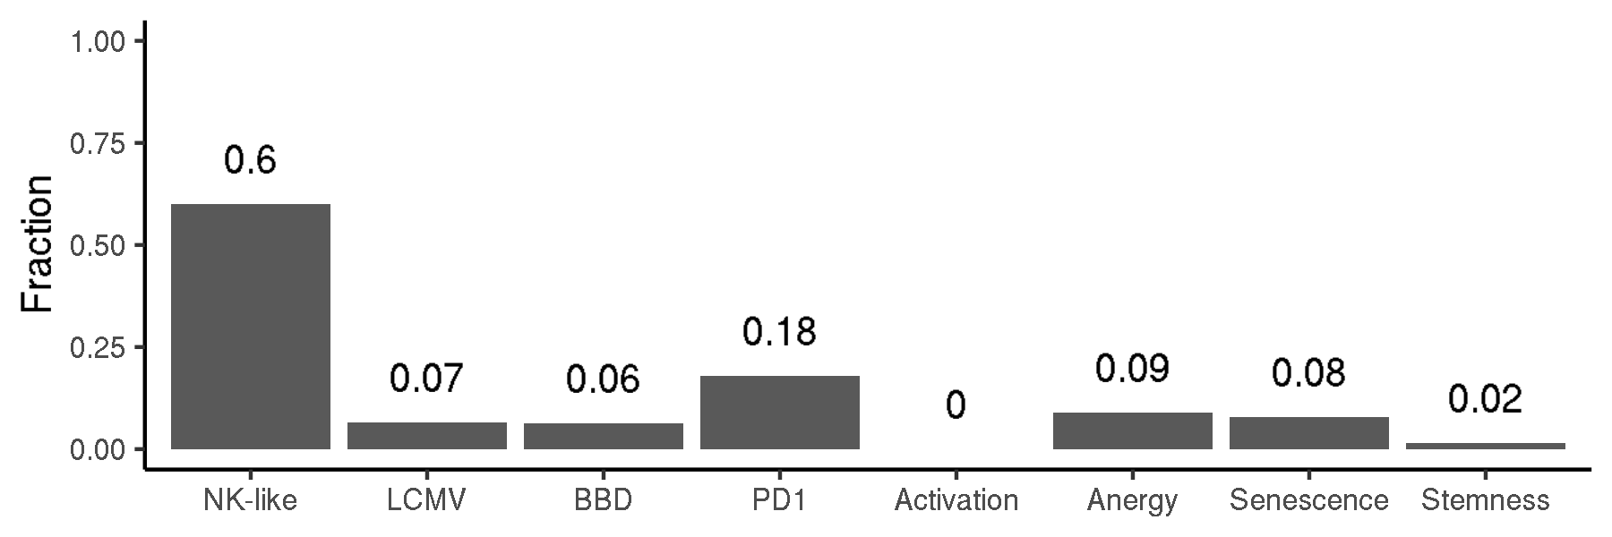
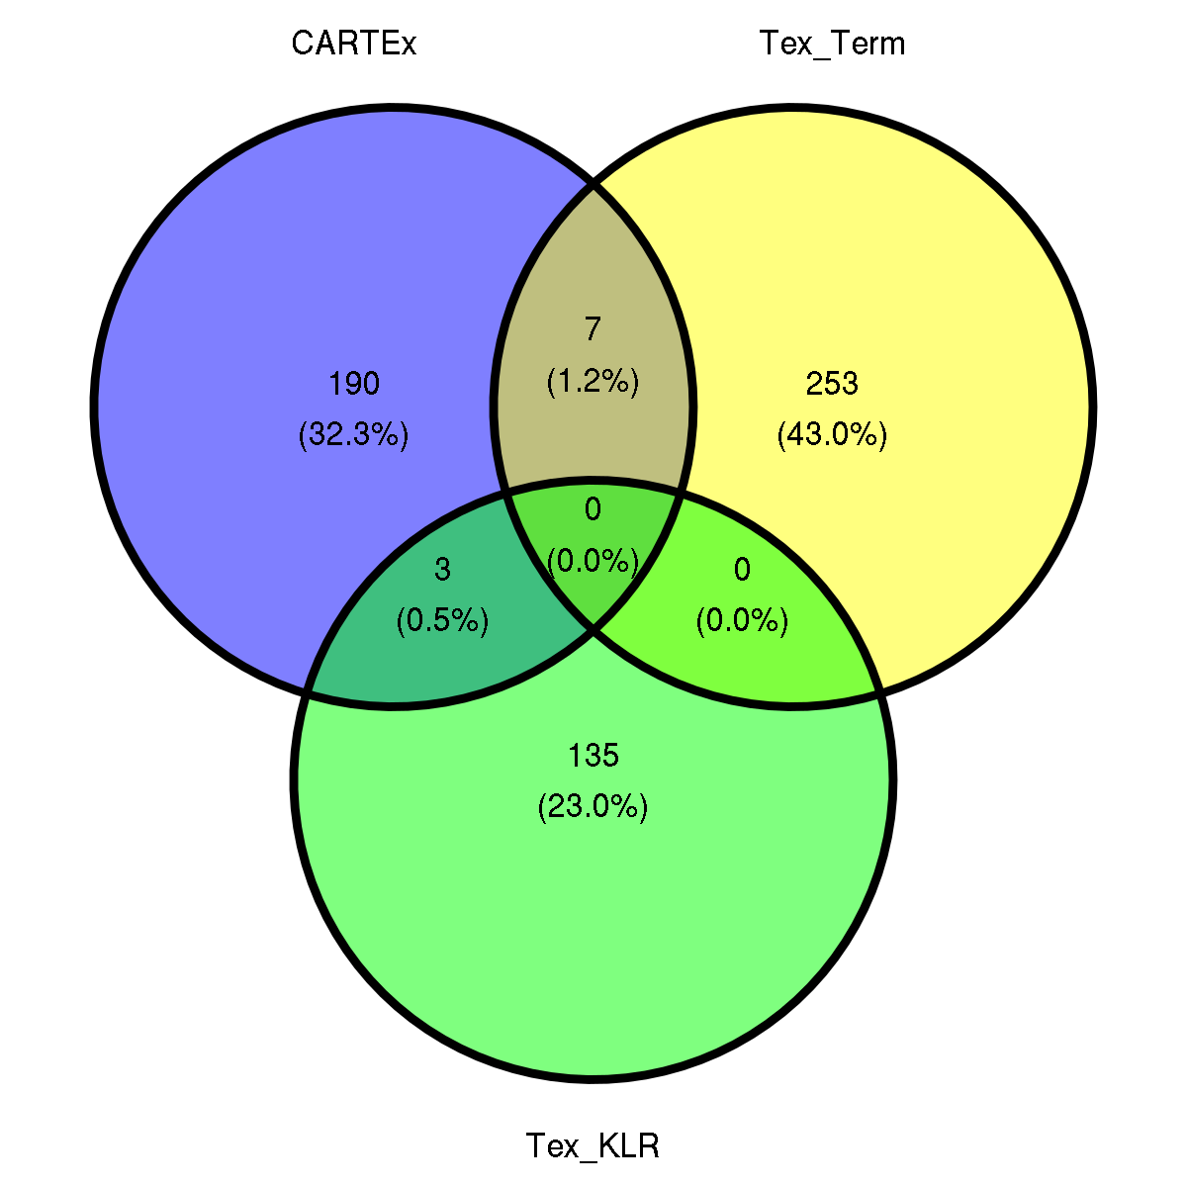
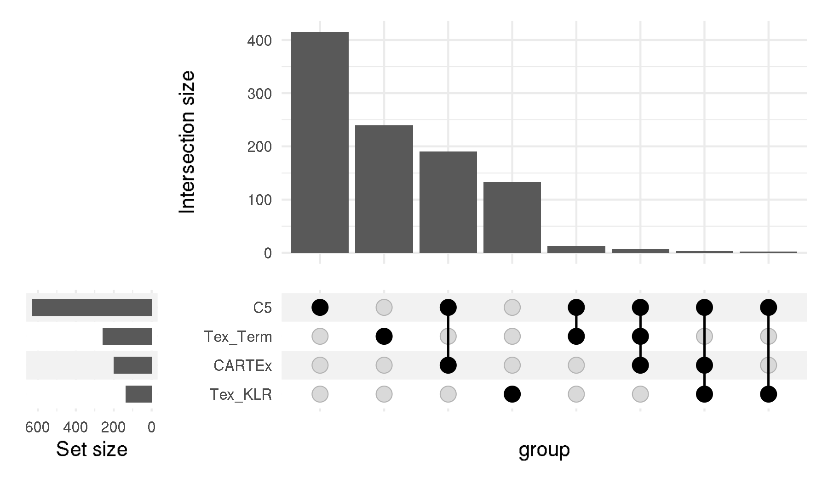
CARTEx project
Supplementary Figure 2. Signature representation
A
B
C
D

Slide 5
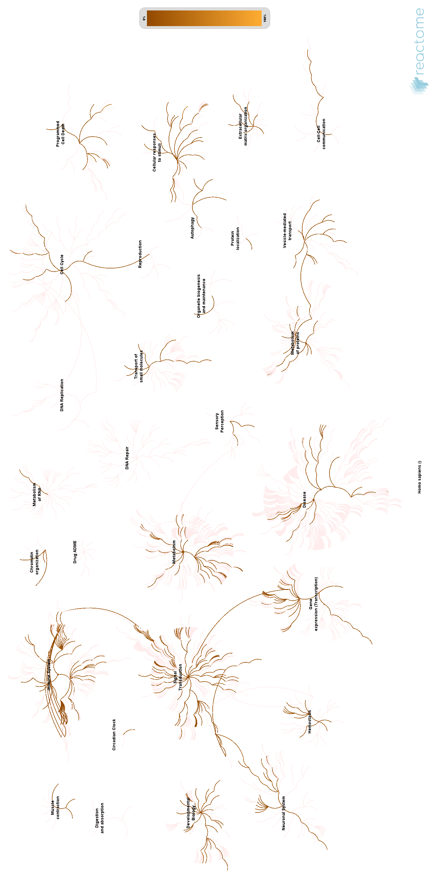
CARTEx project
Supplementary Figure 2. continued
E

Slide 6
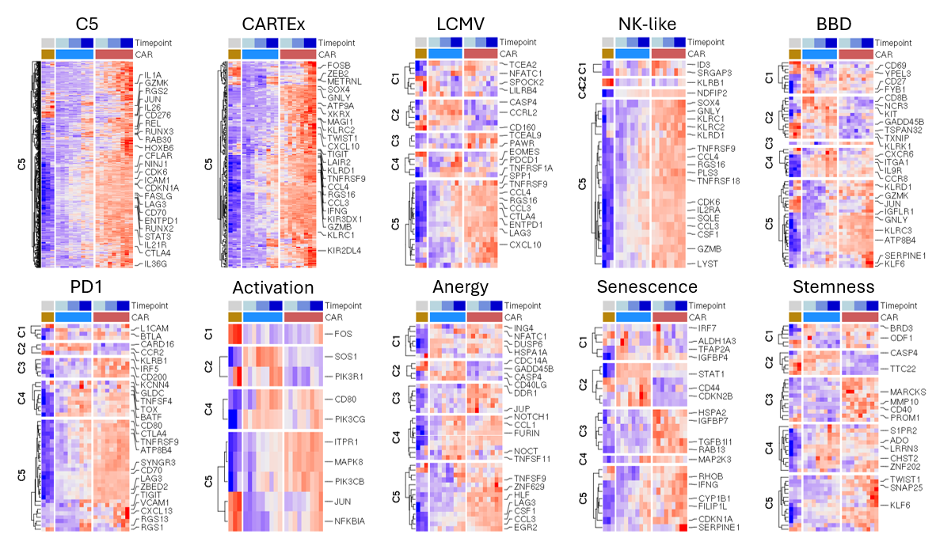
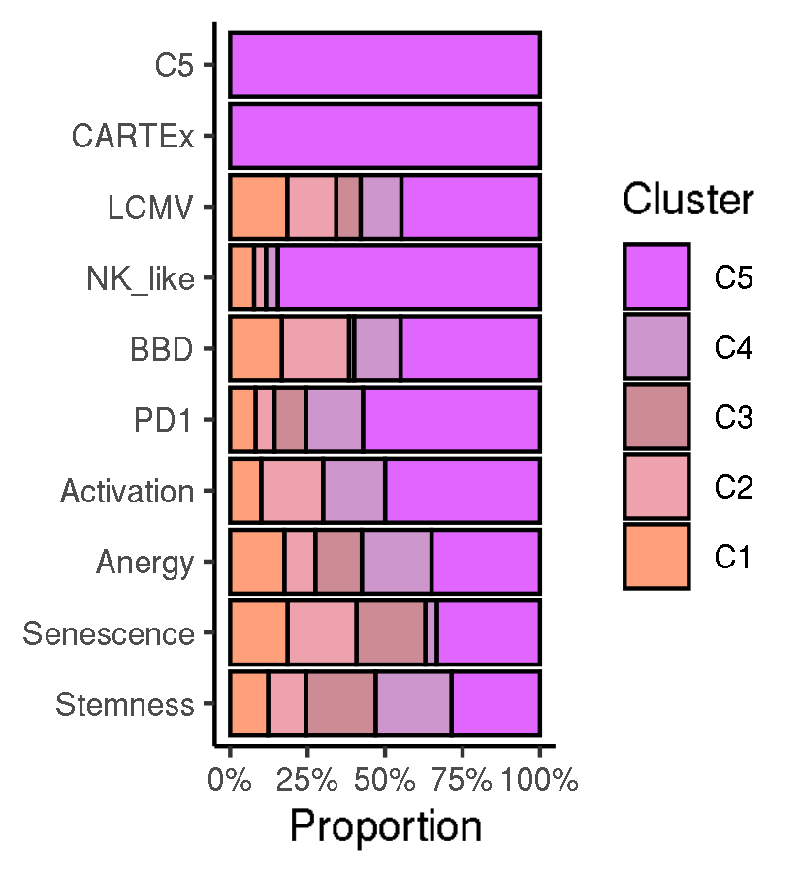
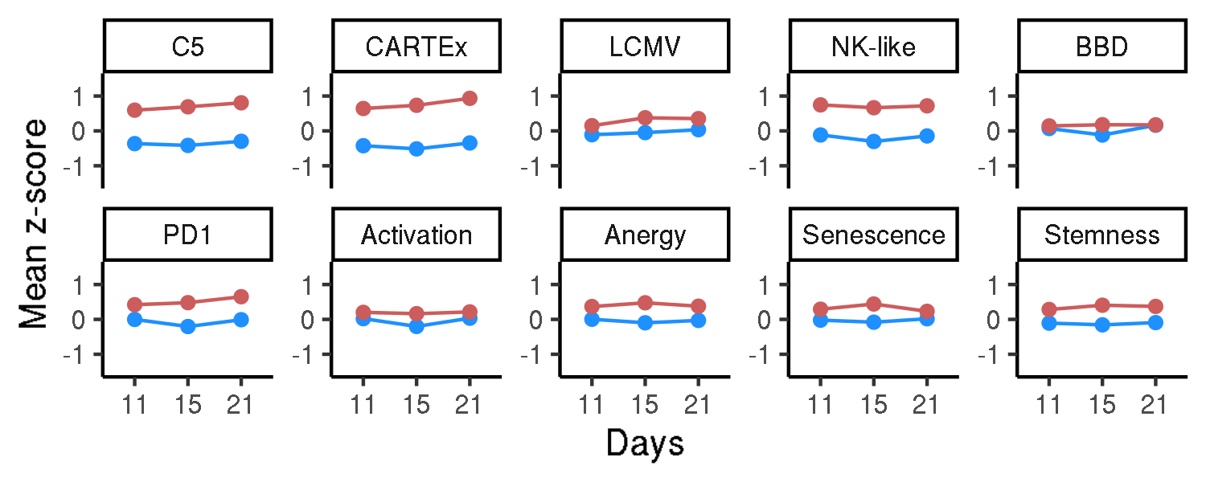
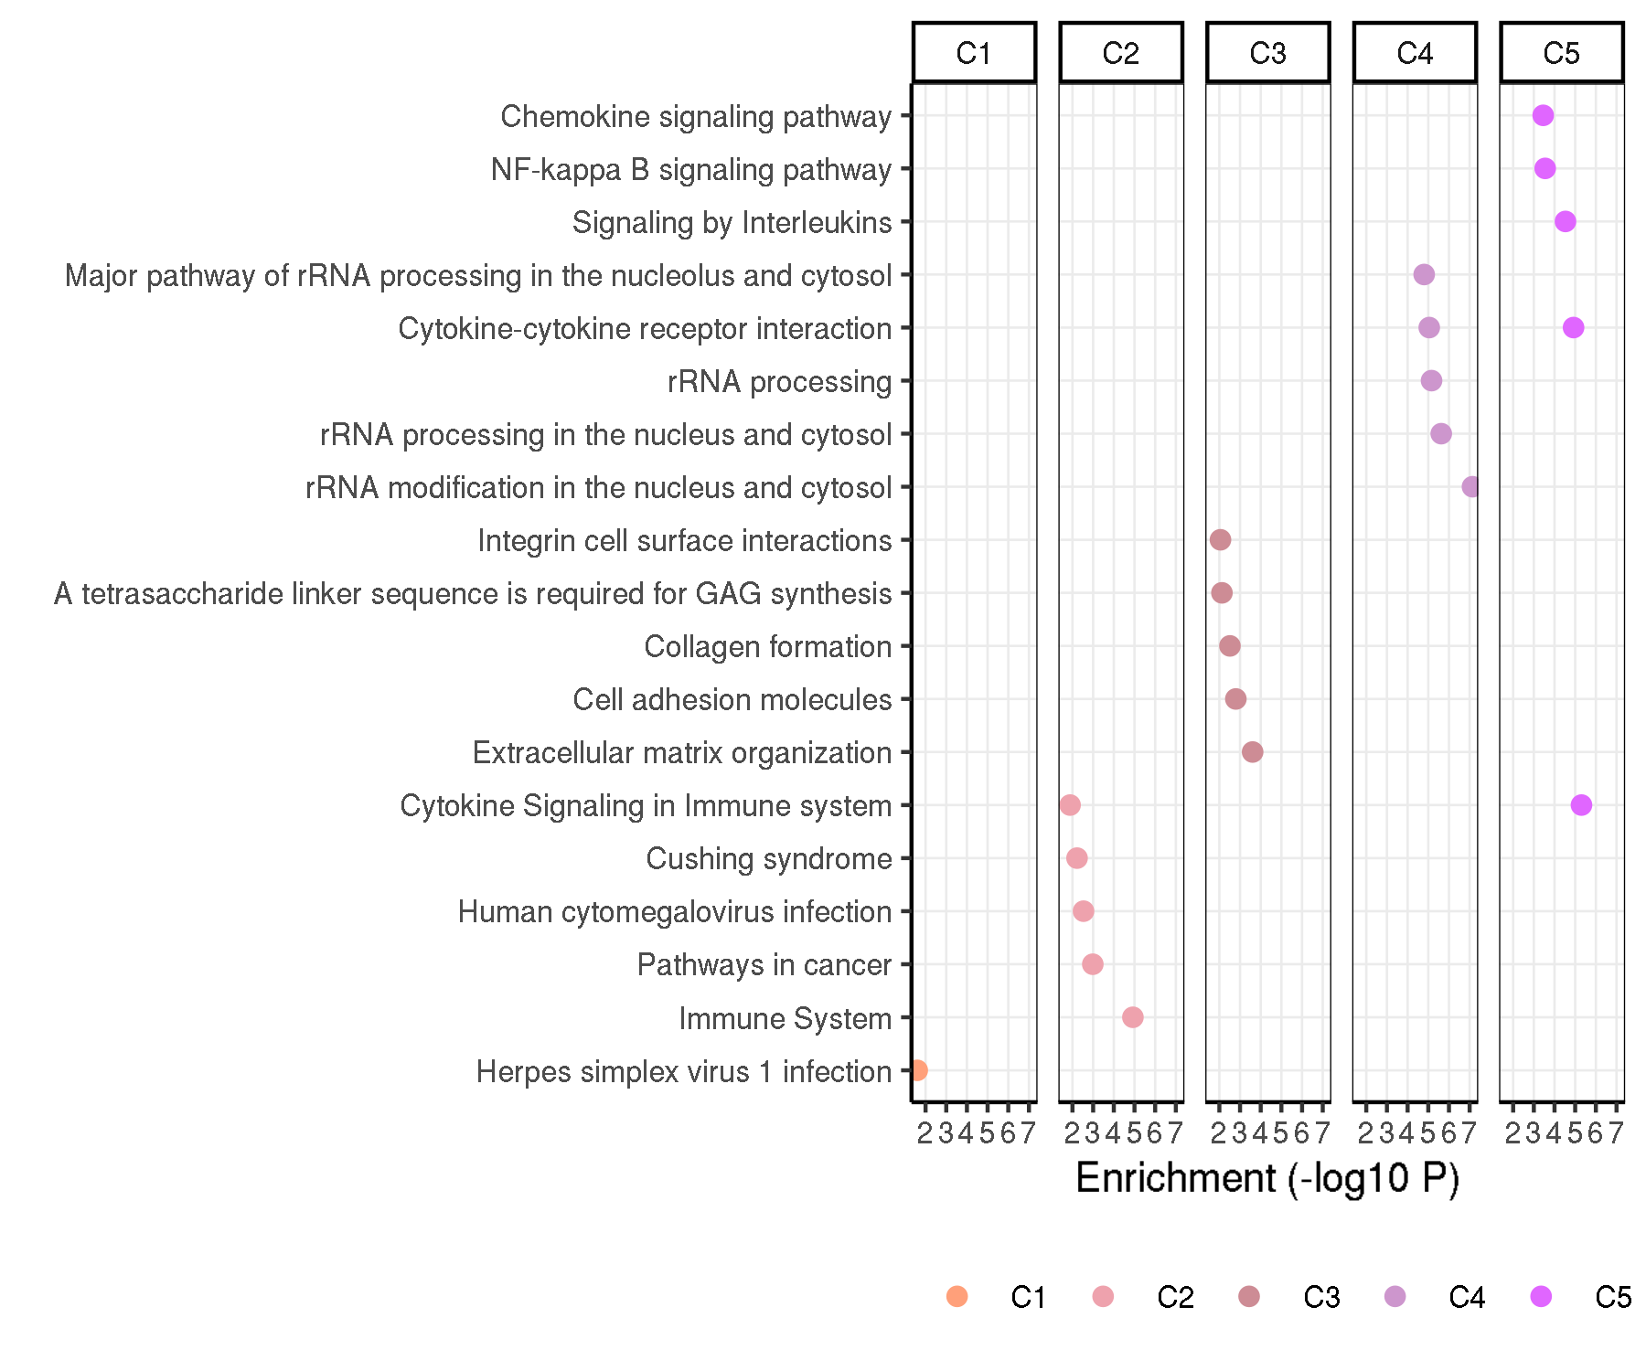
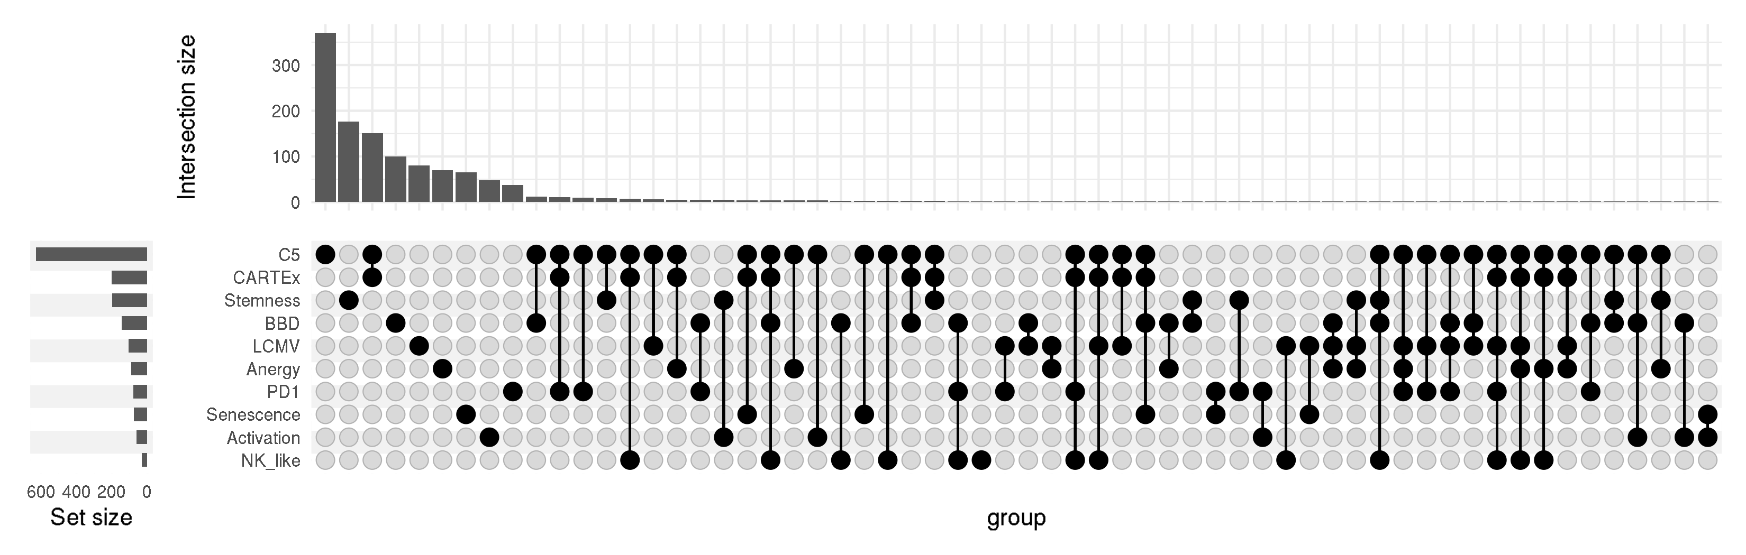
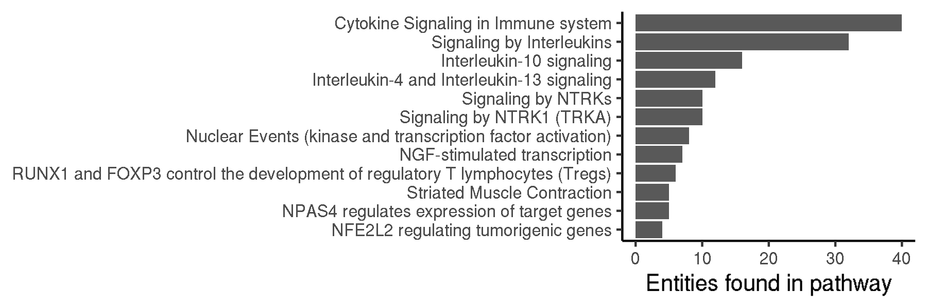
CARTEx project
Figure 2. Biological context / Evaluation with other exhaustion and cell state signatures
A
B
C
E
D
F

Slide 7
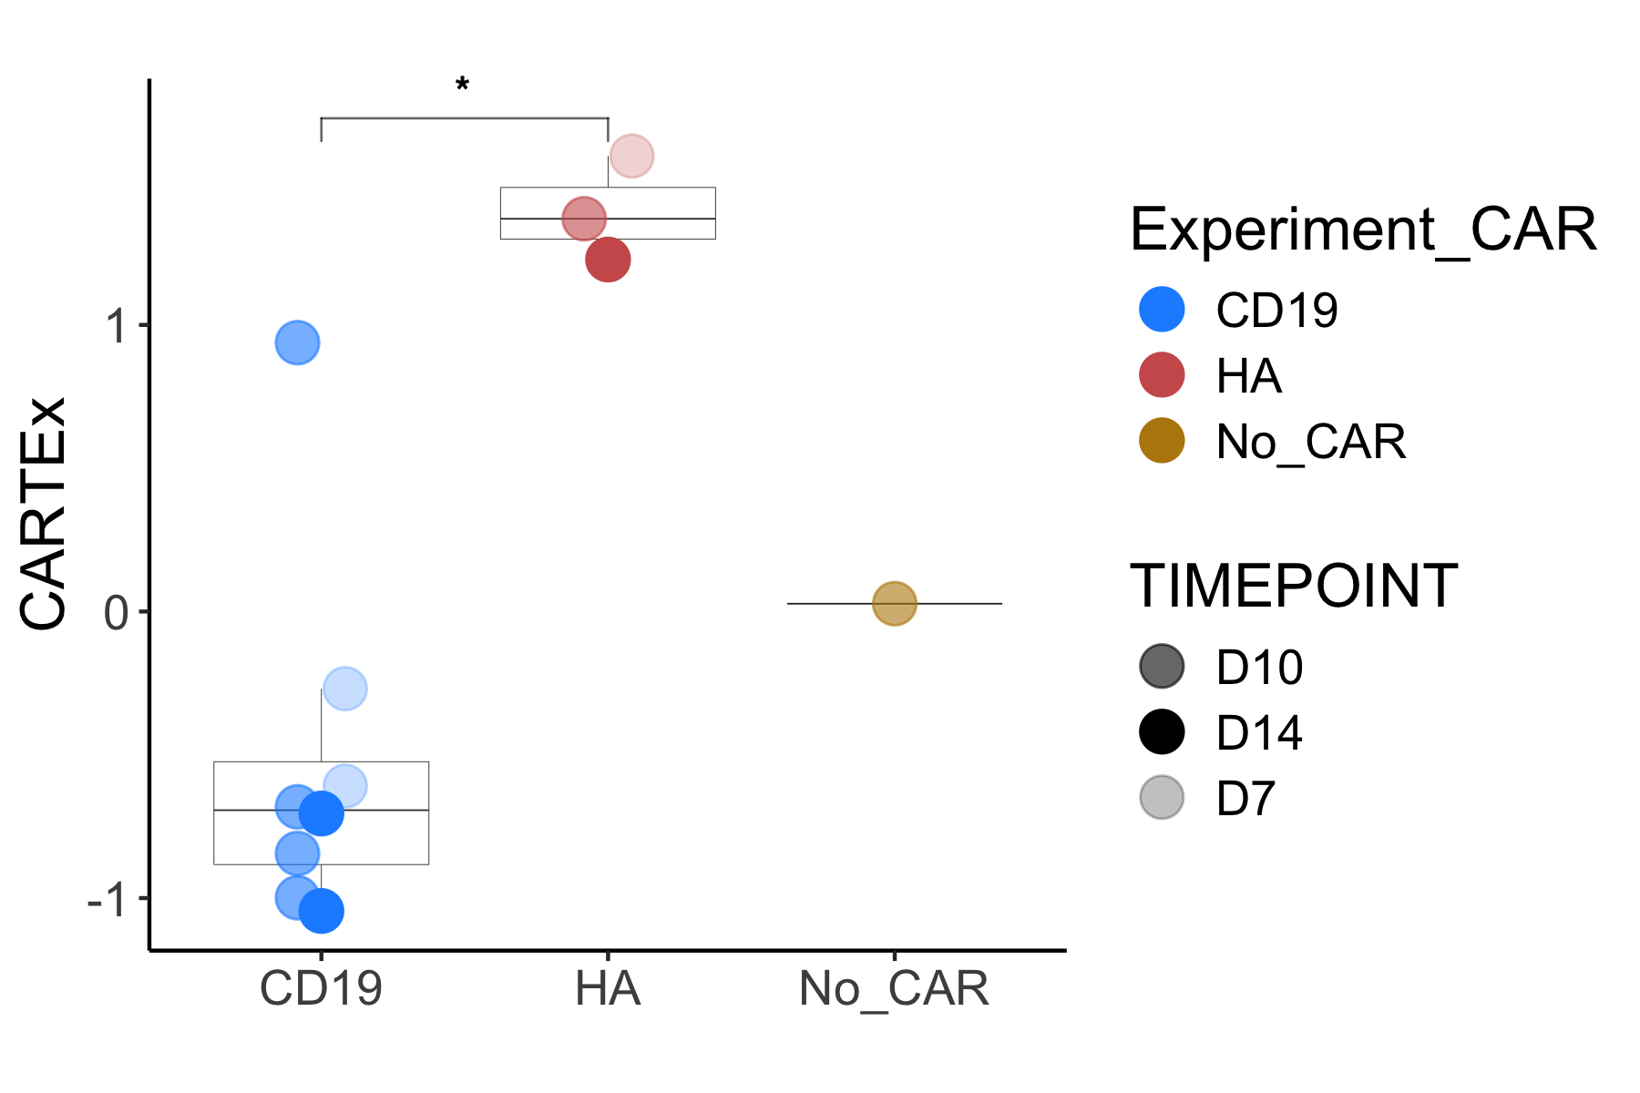
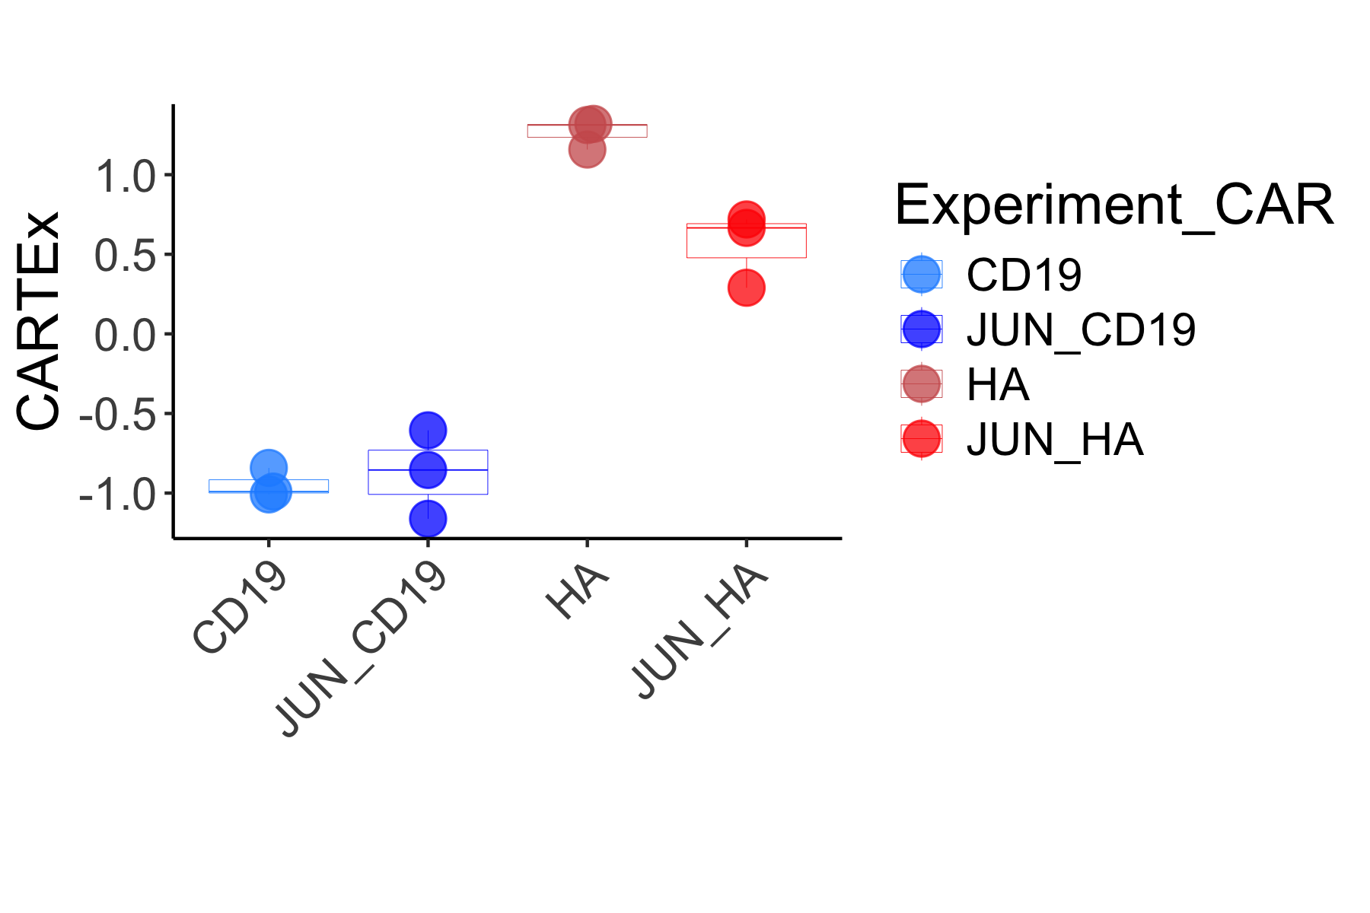
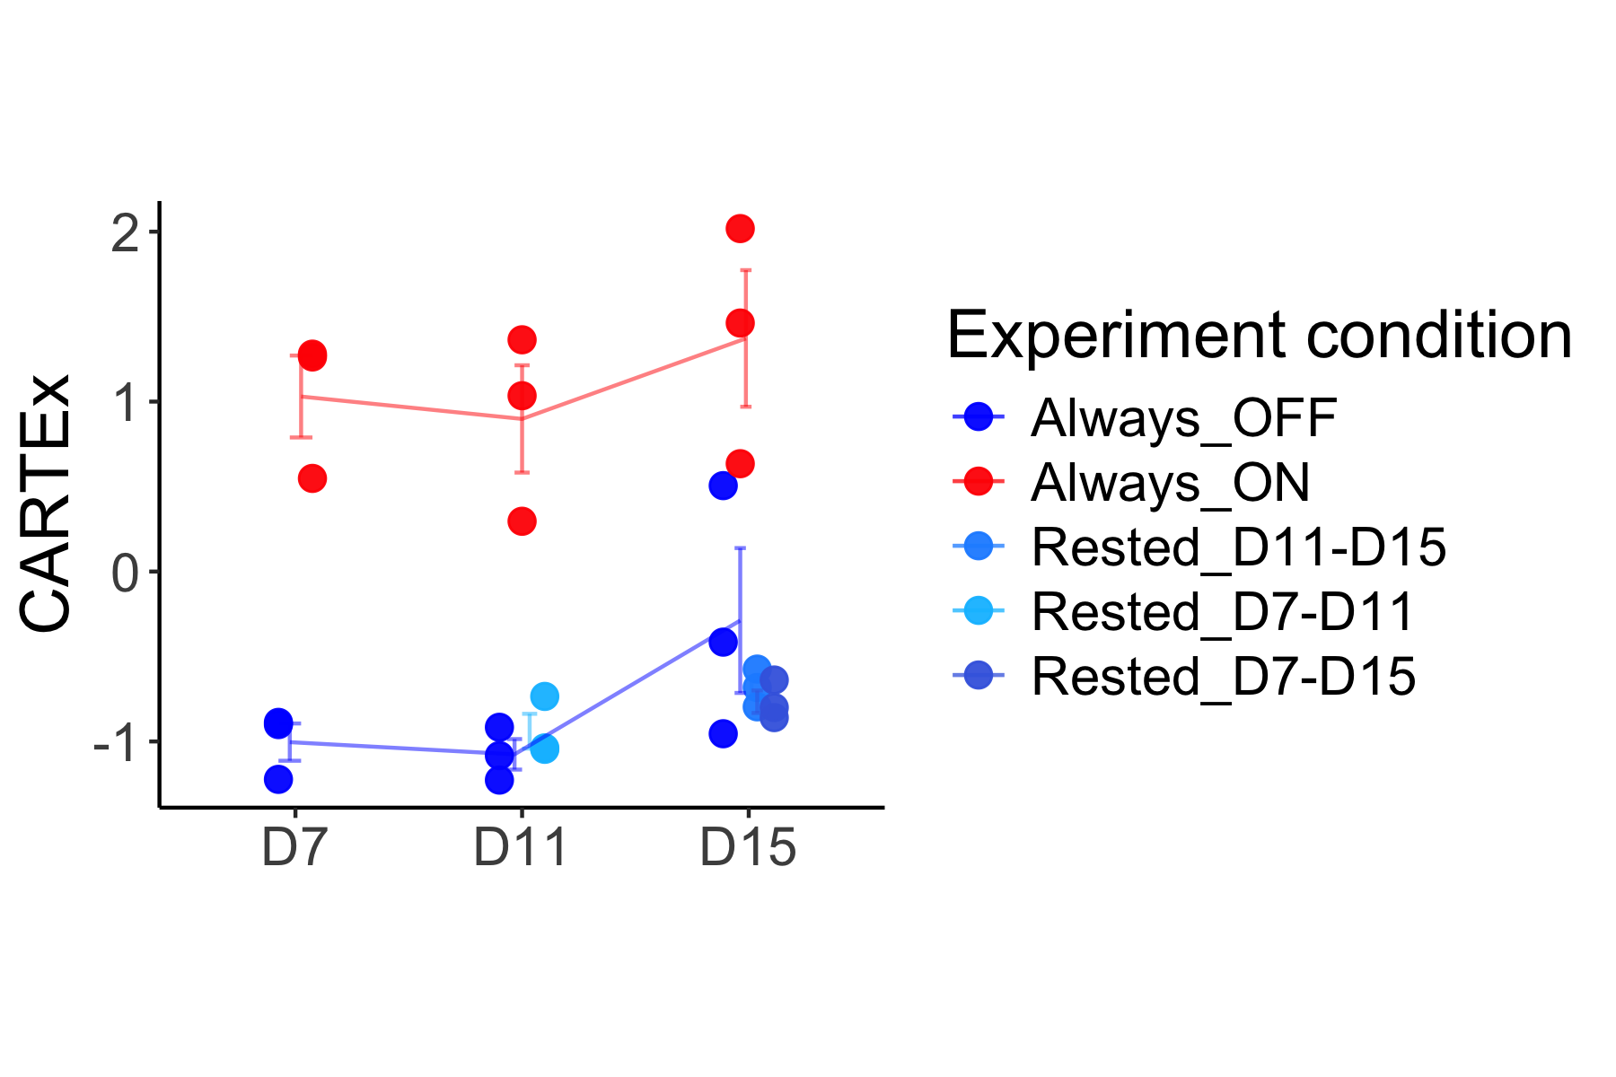
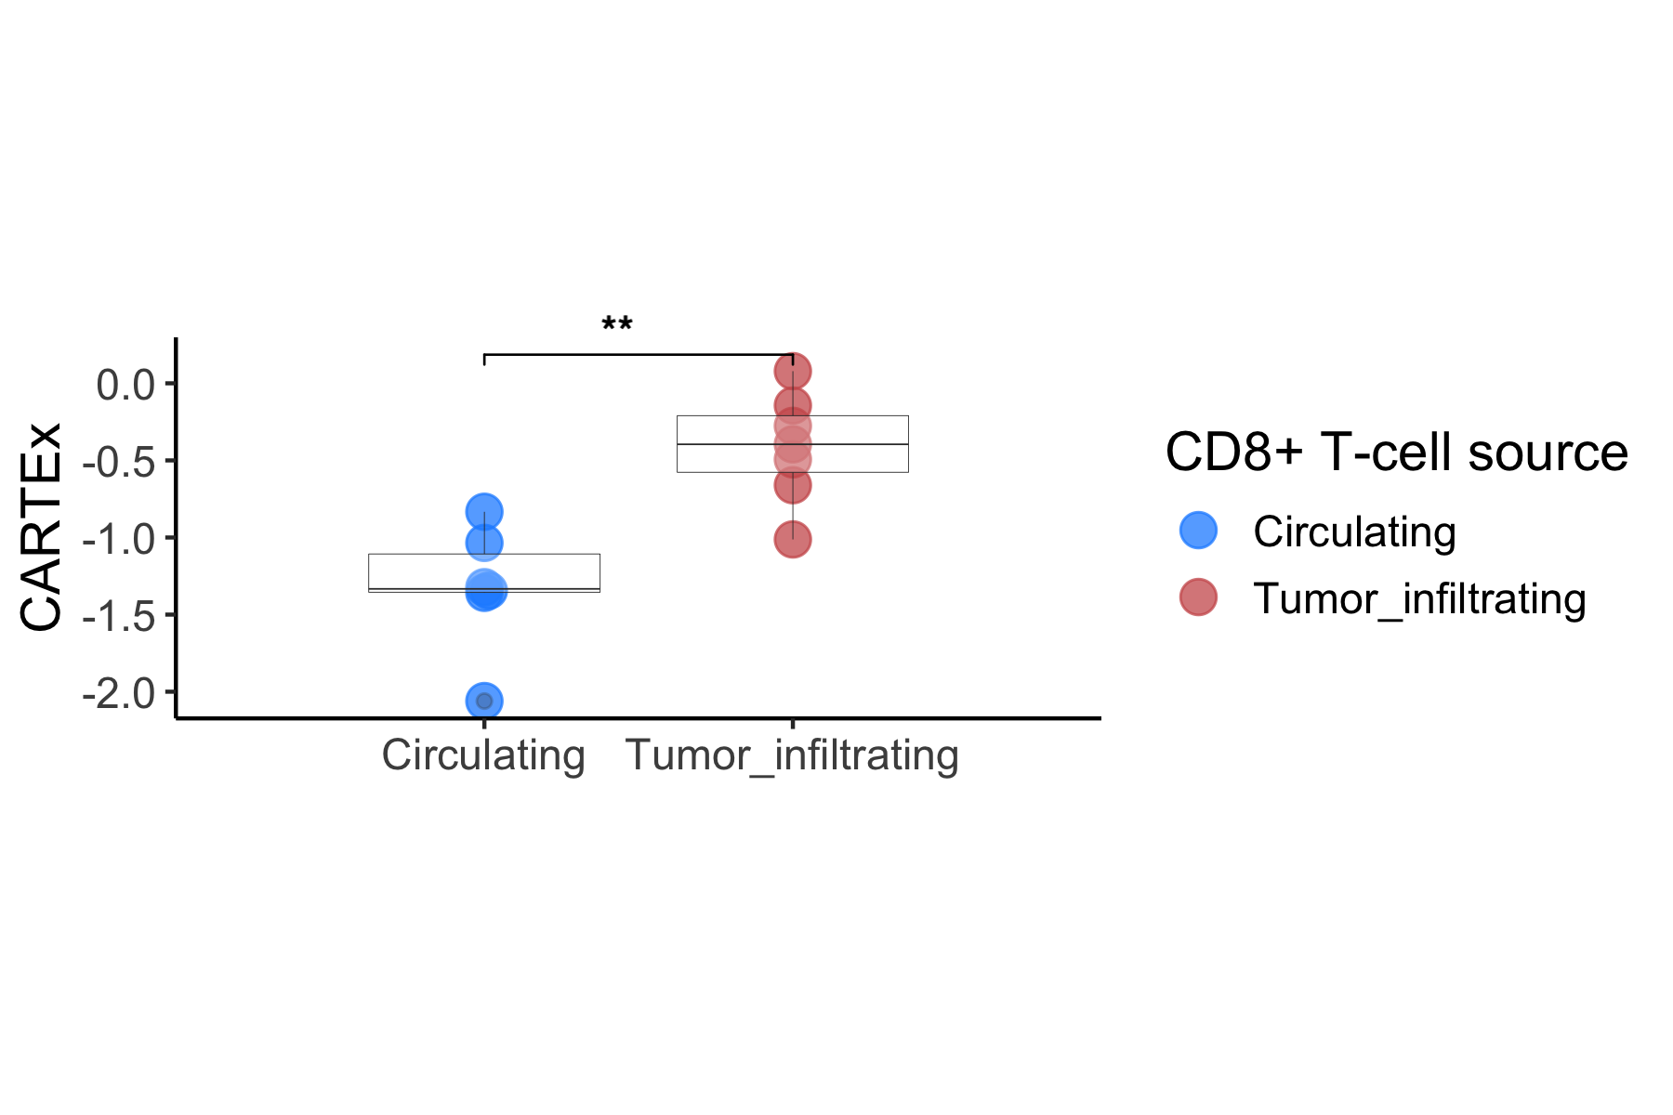
CARTEx project
Supplementary Figure 3. Applying CARTEx signature to bulk RNA sequencing data
A
B
C
D

Slide 8
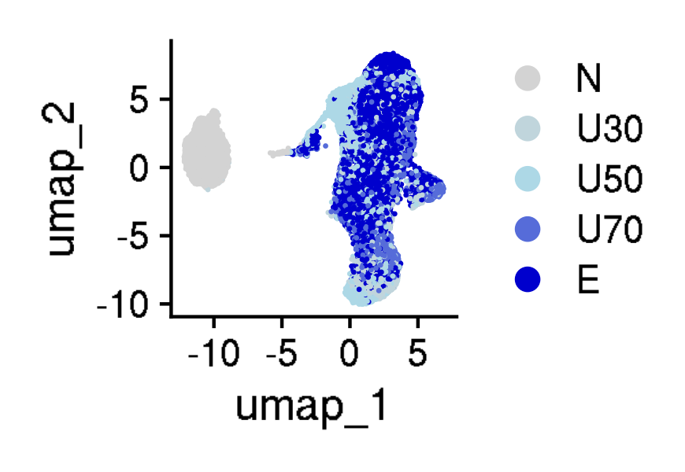
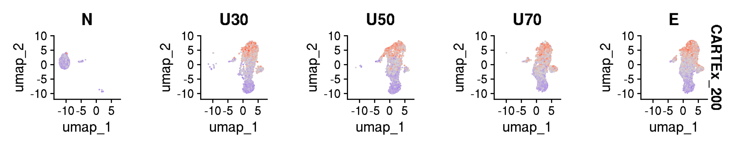
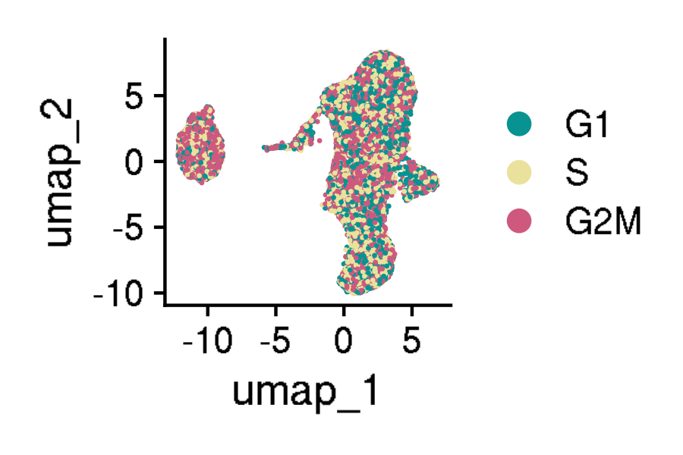
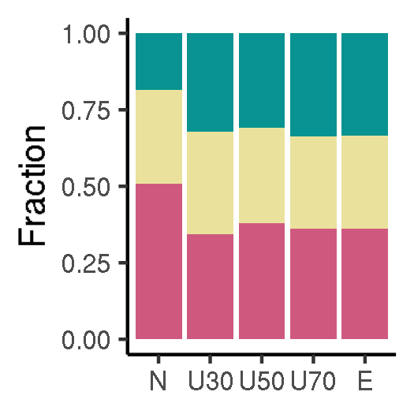
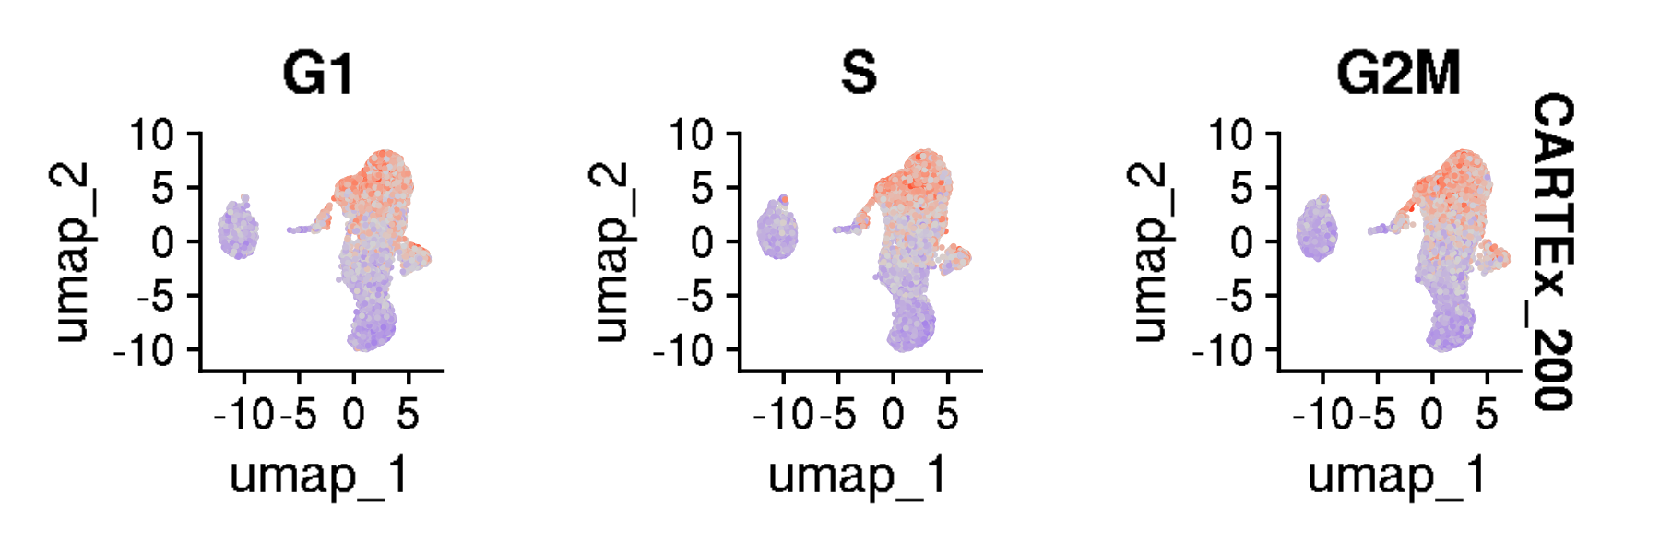
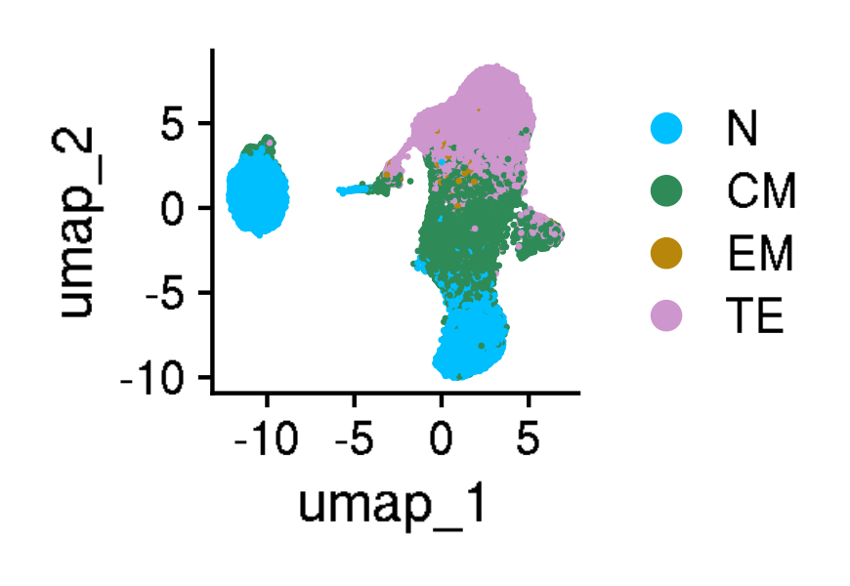
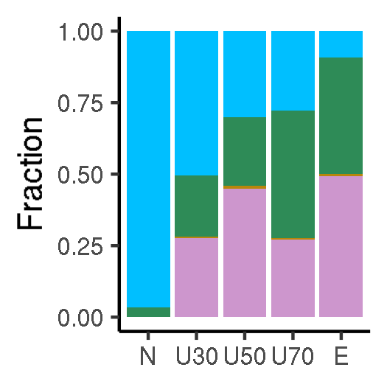
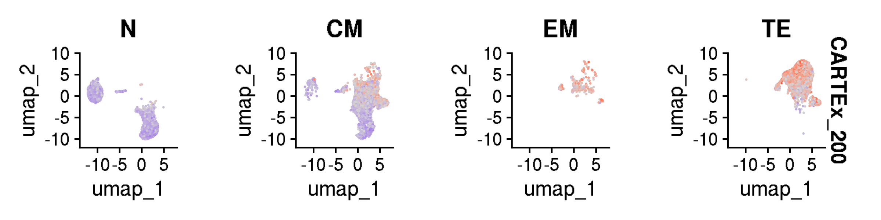
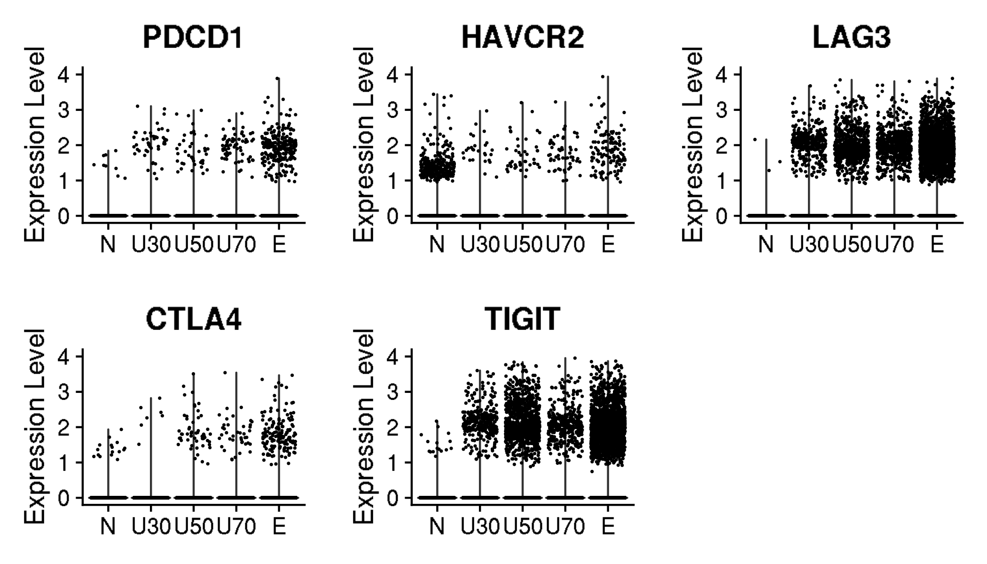
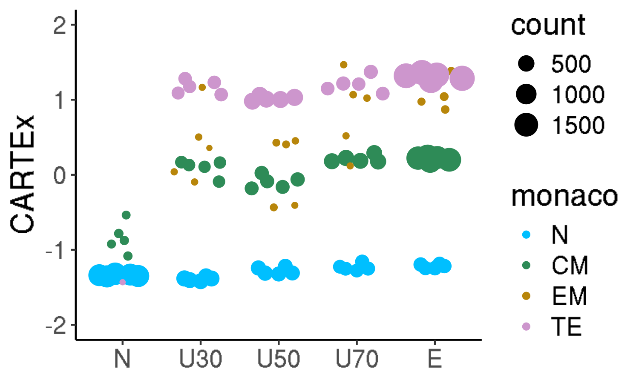
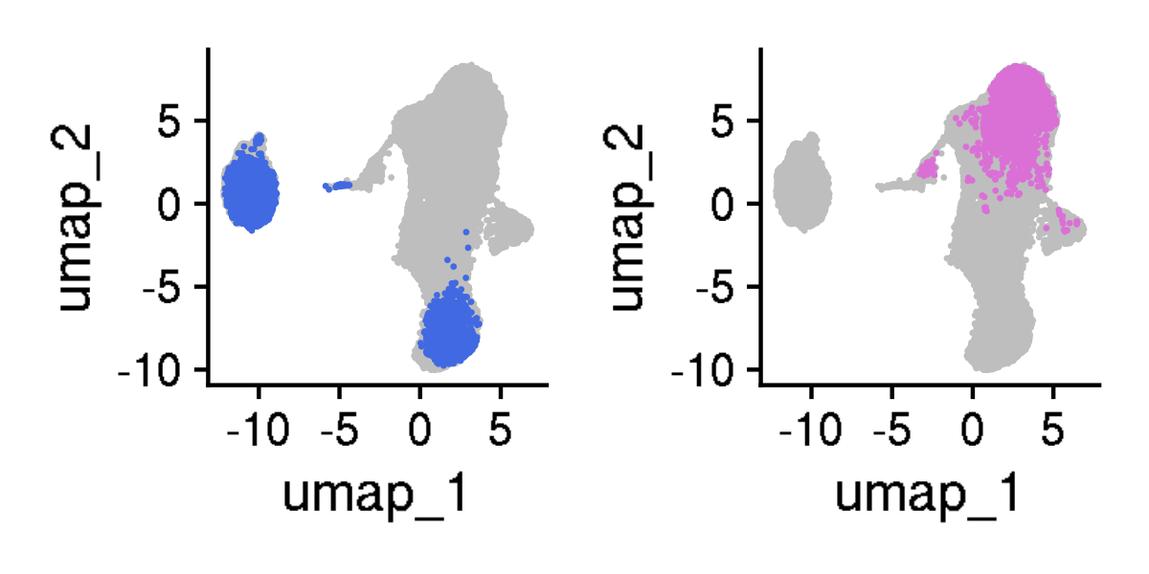
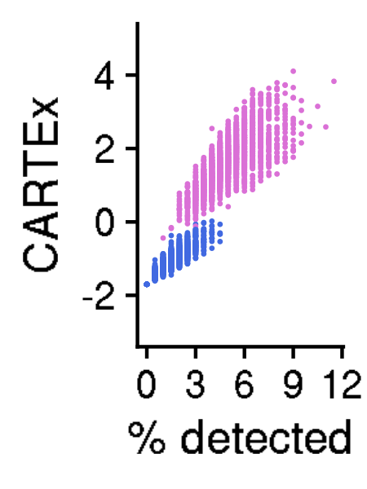
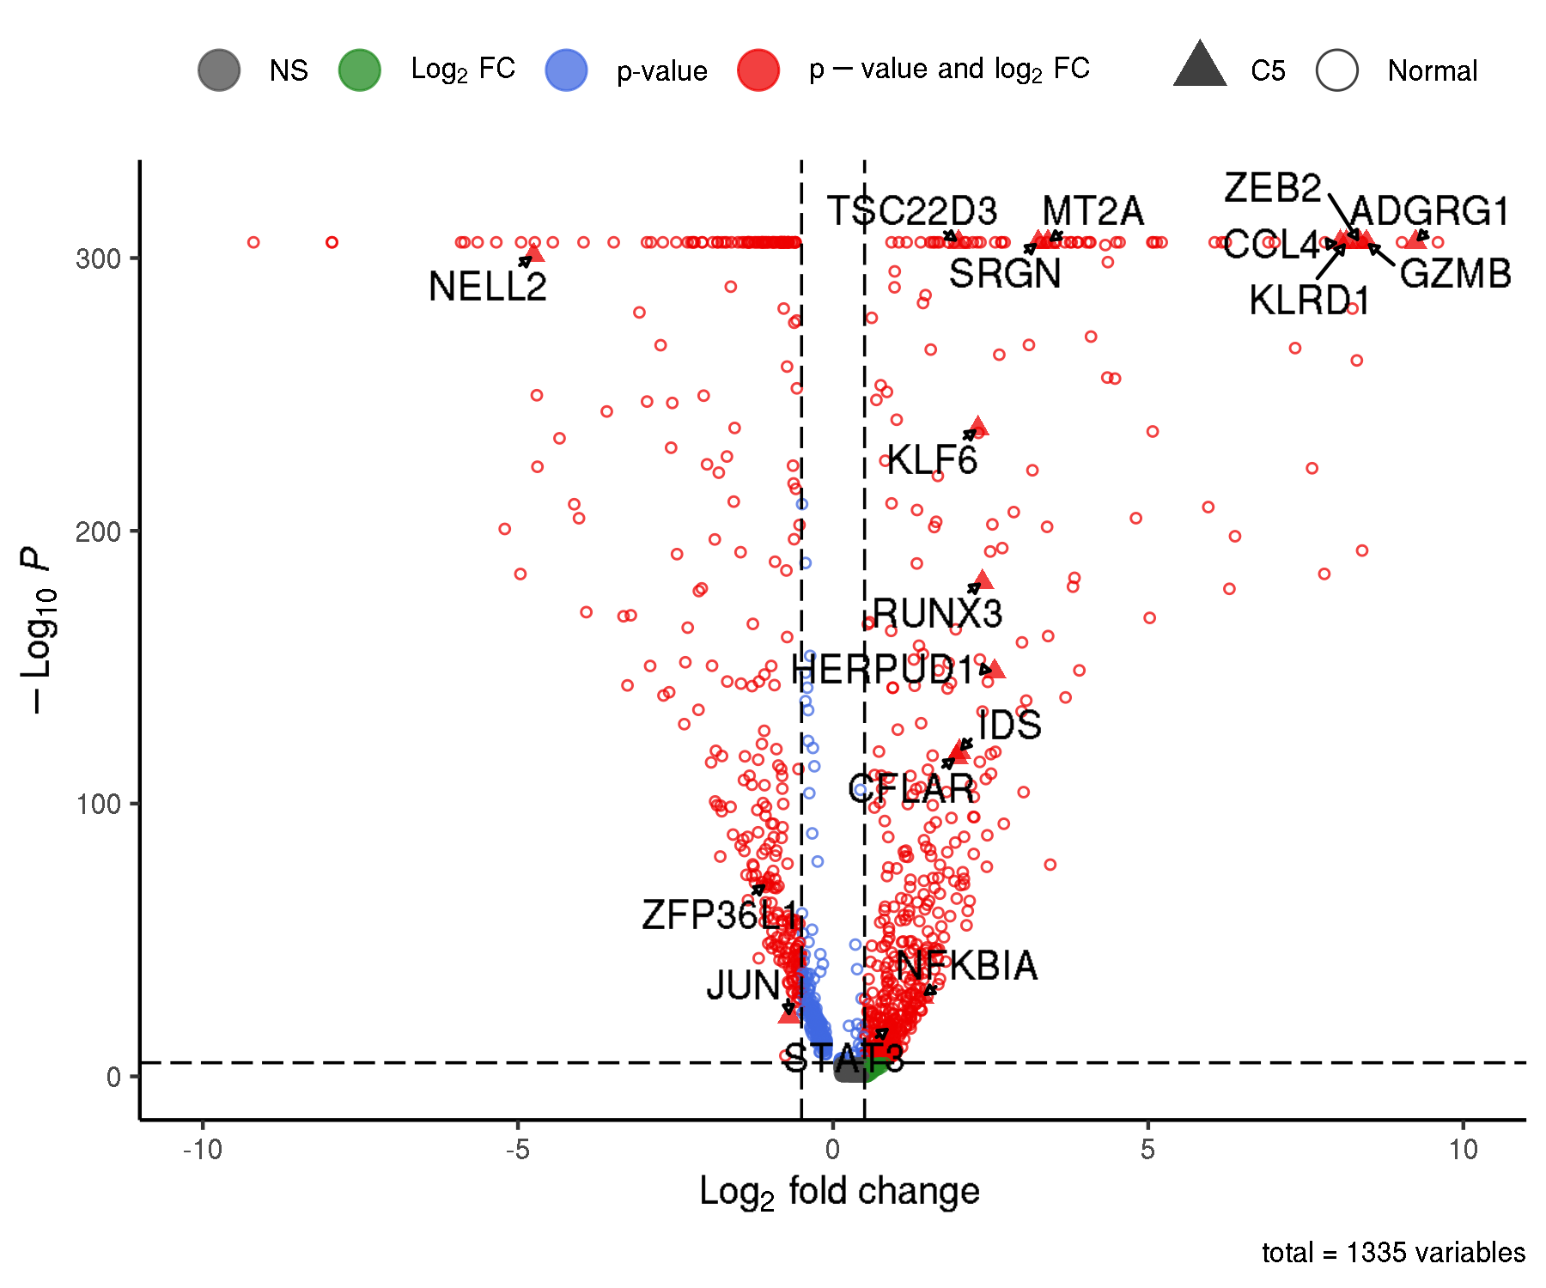
CARTEx project
Figure 3. T cell exhaustion is distinct from aging, cell cycle, and differentiation
A
B
C
D
E
F
G
H
I
J
K

Slide 9
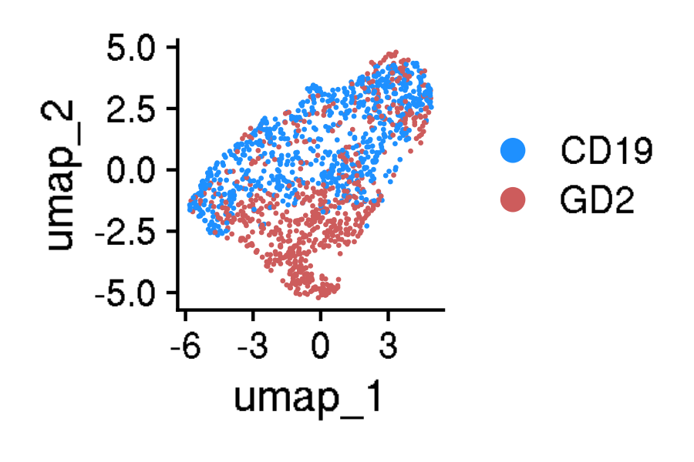
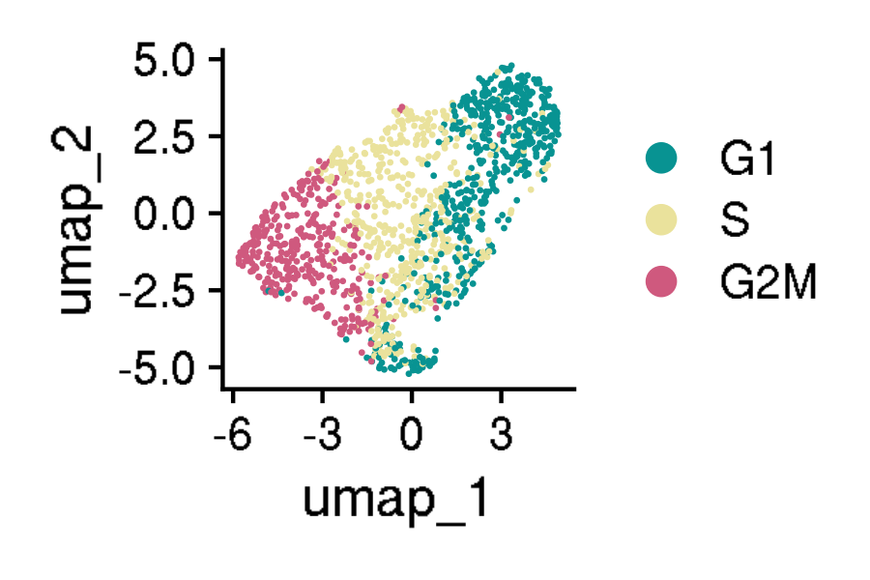
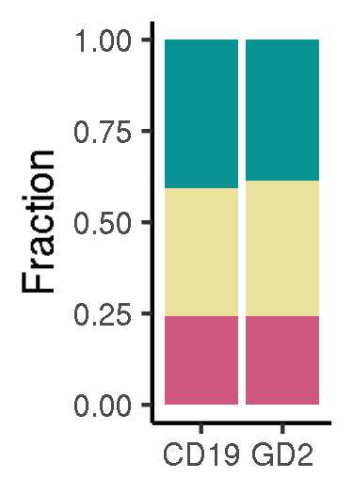
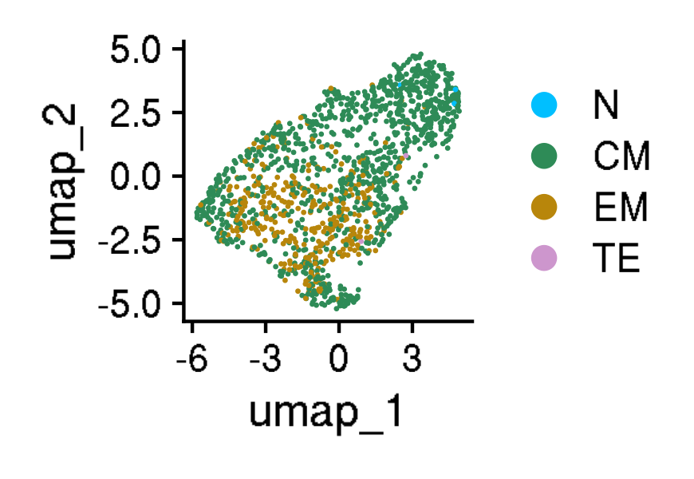
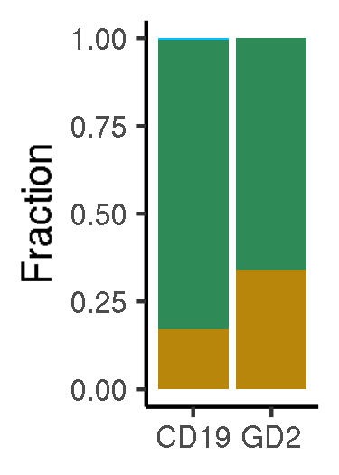
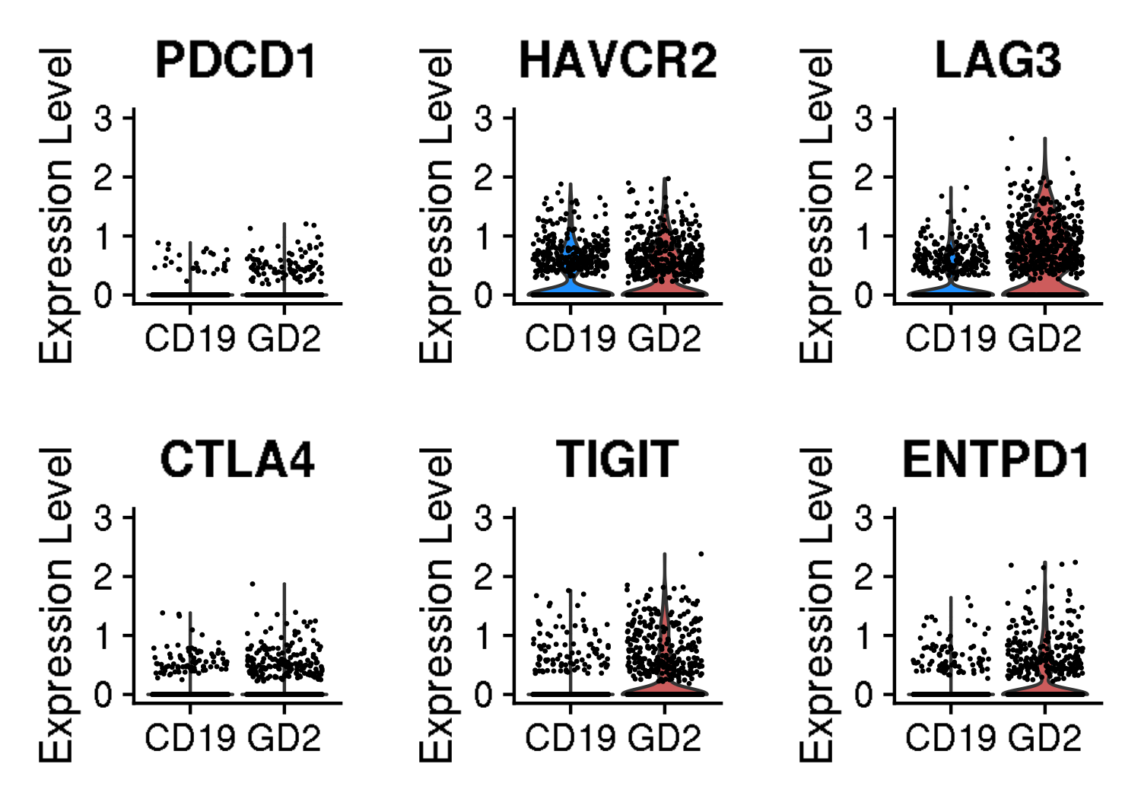






















CARTEx project
Figure 4. Validation in exhaustion-prone models
A
B
C
D
E
F
G
H
I
J
K
L
M
N
O
P
Q
R
S
T
U
V

Slide 10
























CARTEx project
Supplementary Figure 4. validation in exhaustion-prone models
A
A

Slide 11














CARTEx project
Supplementary Figure 5. Activation and resting T cells from healthy donors
A
B
C
D
E
F
G
H
I
J
K
L

Slide 12













CARTEx project
Supplementary figures. T cells from healthy donors and cancer patients (MD Anderson pan-cancer)
A
B
C
D
E
F
G
H
I

Slide 13





























CARTEx project
Figure 5. CARTEx applied to clinical oncology

Slide 14













CARTEx project
Supplementary Figure. COVID-19 severity and SARS-CoV-2-reactive T cell exhaustion

Slide 15












CARTEx project
Figure6. CARTEx applied to CD8 T cells in autoimmune disorders

Slide 16













CARTEx project
Supplementary Figure. More STAT3 GOF

Slide 17







CARTEx project
Supplementary Figure. More STAT3 GOF (cell type differentiation)

Slide 18














CARTEx project
Supplementary Figure. More STAT3 GOF (diffusion maps)

Slide 19










CARTEx project
Supplementary Figure. Severe psoriasis is distinct from T cell exhaustion

Slide 20











CARTEx project
Supplementary Figure. BEACH domain deficiencies (autoimmunity caused by defective CTLA-4 trafficking)

Slide 21















CARTEx project
Supplementary Figure. T cell exhaustion in neurodegenerative diseases

Slide 22
CARTEx project
EXTRA SLIDES

Slide 23








CARTEx project
Supplementary Figures for aging dataset (this is longitudinal data)
A
B
A

Slide 24





CARTEx project
Supplementary Figures for aging dataset (head-to-head comparison with various signatures)

Slide 25






CARTEx project
Supplementary Figures for validation in exhaustion-prone models

Slide 26


CARTEx project
Supplementary Figures for validation in exhaustion-prone models

Slide 27





CARTEx project
Supplementary Figure for CARTEx applied to clinical oncology

Slide 28
























CARTEx project
Supplementary Figure for CARTEx applied to clinical oncology

Slide 29












CARTEx project
Supplementary Figure for CARTEx applied to clinical COVID-19

